Slide 1
These presentations are to be used as teaching aids alongside the teachers’ guide and children’s workbooks for the Christmas lesson 2023.
All rights reserved. No part of this scheme may be reprinted, reproduced or utilised in any form by any electronic, mechanical, or other means, now known or hereafter invented, including photography and recording, or in any information storage and retrieval system, without permission in writing from the copywrite owner. We please ask all purchasing schools to not share with others without prior permission. Thank you for your support.
© E. Skeldon & J. Warburton 2023

Slide 2
It’s Christmas! – Lesson Plan
Play the clips of Christmas songs to the children. Can they sing the next lyric?
Task 1. Read closely and carefully the etymology of the name Rudolph. Discuss this with children and check for understanding.
Task 2. Children are to match the festive words to their definitions. Discuss with children where they have heard these words and ask them to put the words into a sentence. (Click words in blue for a definition.)
Task 3. Explore with children the meaning of the word festive. Using the words on the presentation to help them children are to explain how the word festive might sound, smell, taste and feel. Children are then to write their own sentence that accurately uses the word festive.
In pairs, how many festive words can children list or say?

Slide 3
It’s Christmas!
Finish the lyric!
Get into the Christmas spirit by singing the next lyric from these well know Christmas songs.
Answer
Answer
Answer
Answer
Underneath the Christmas tree
He began to dance around.
Six geese a-laying
This year to save me from tears

Slide 4
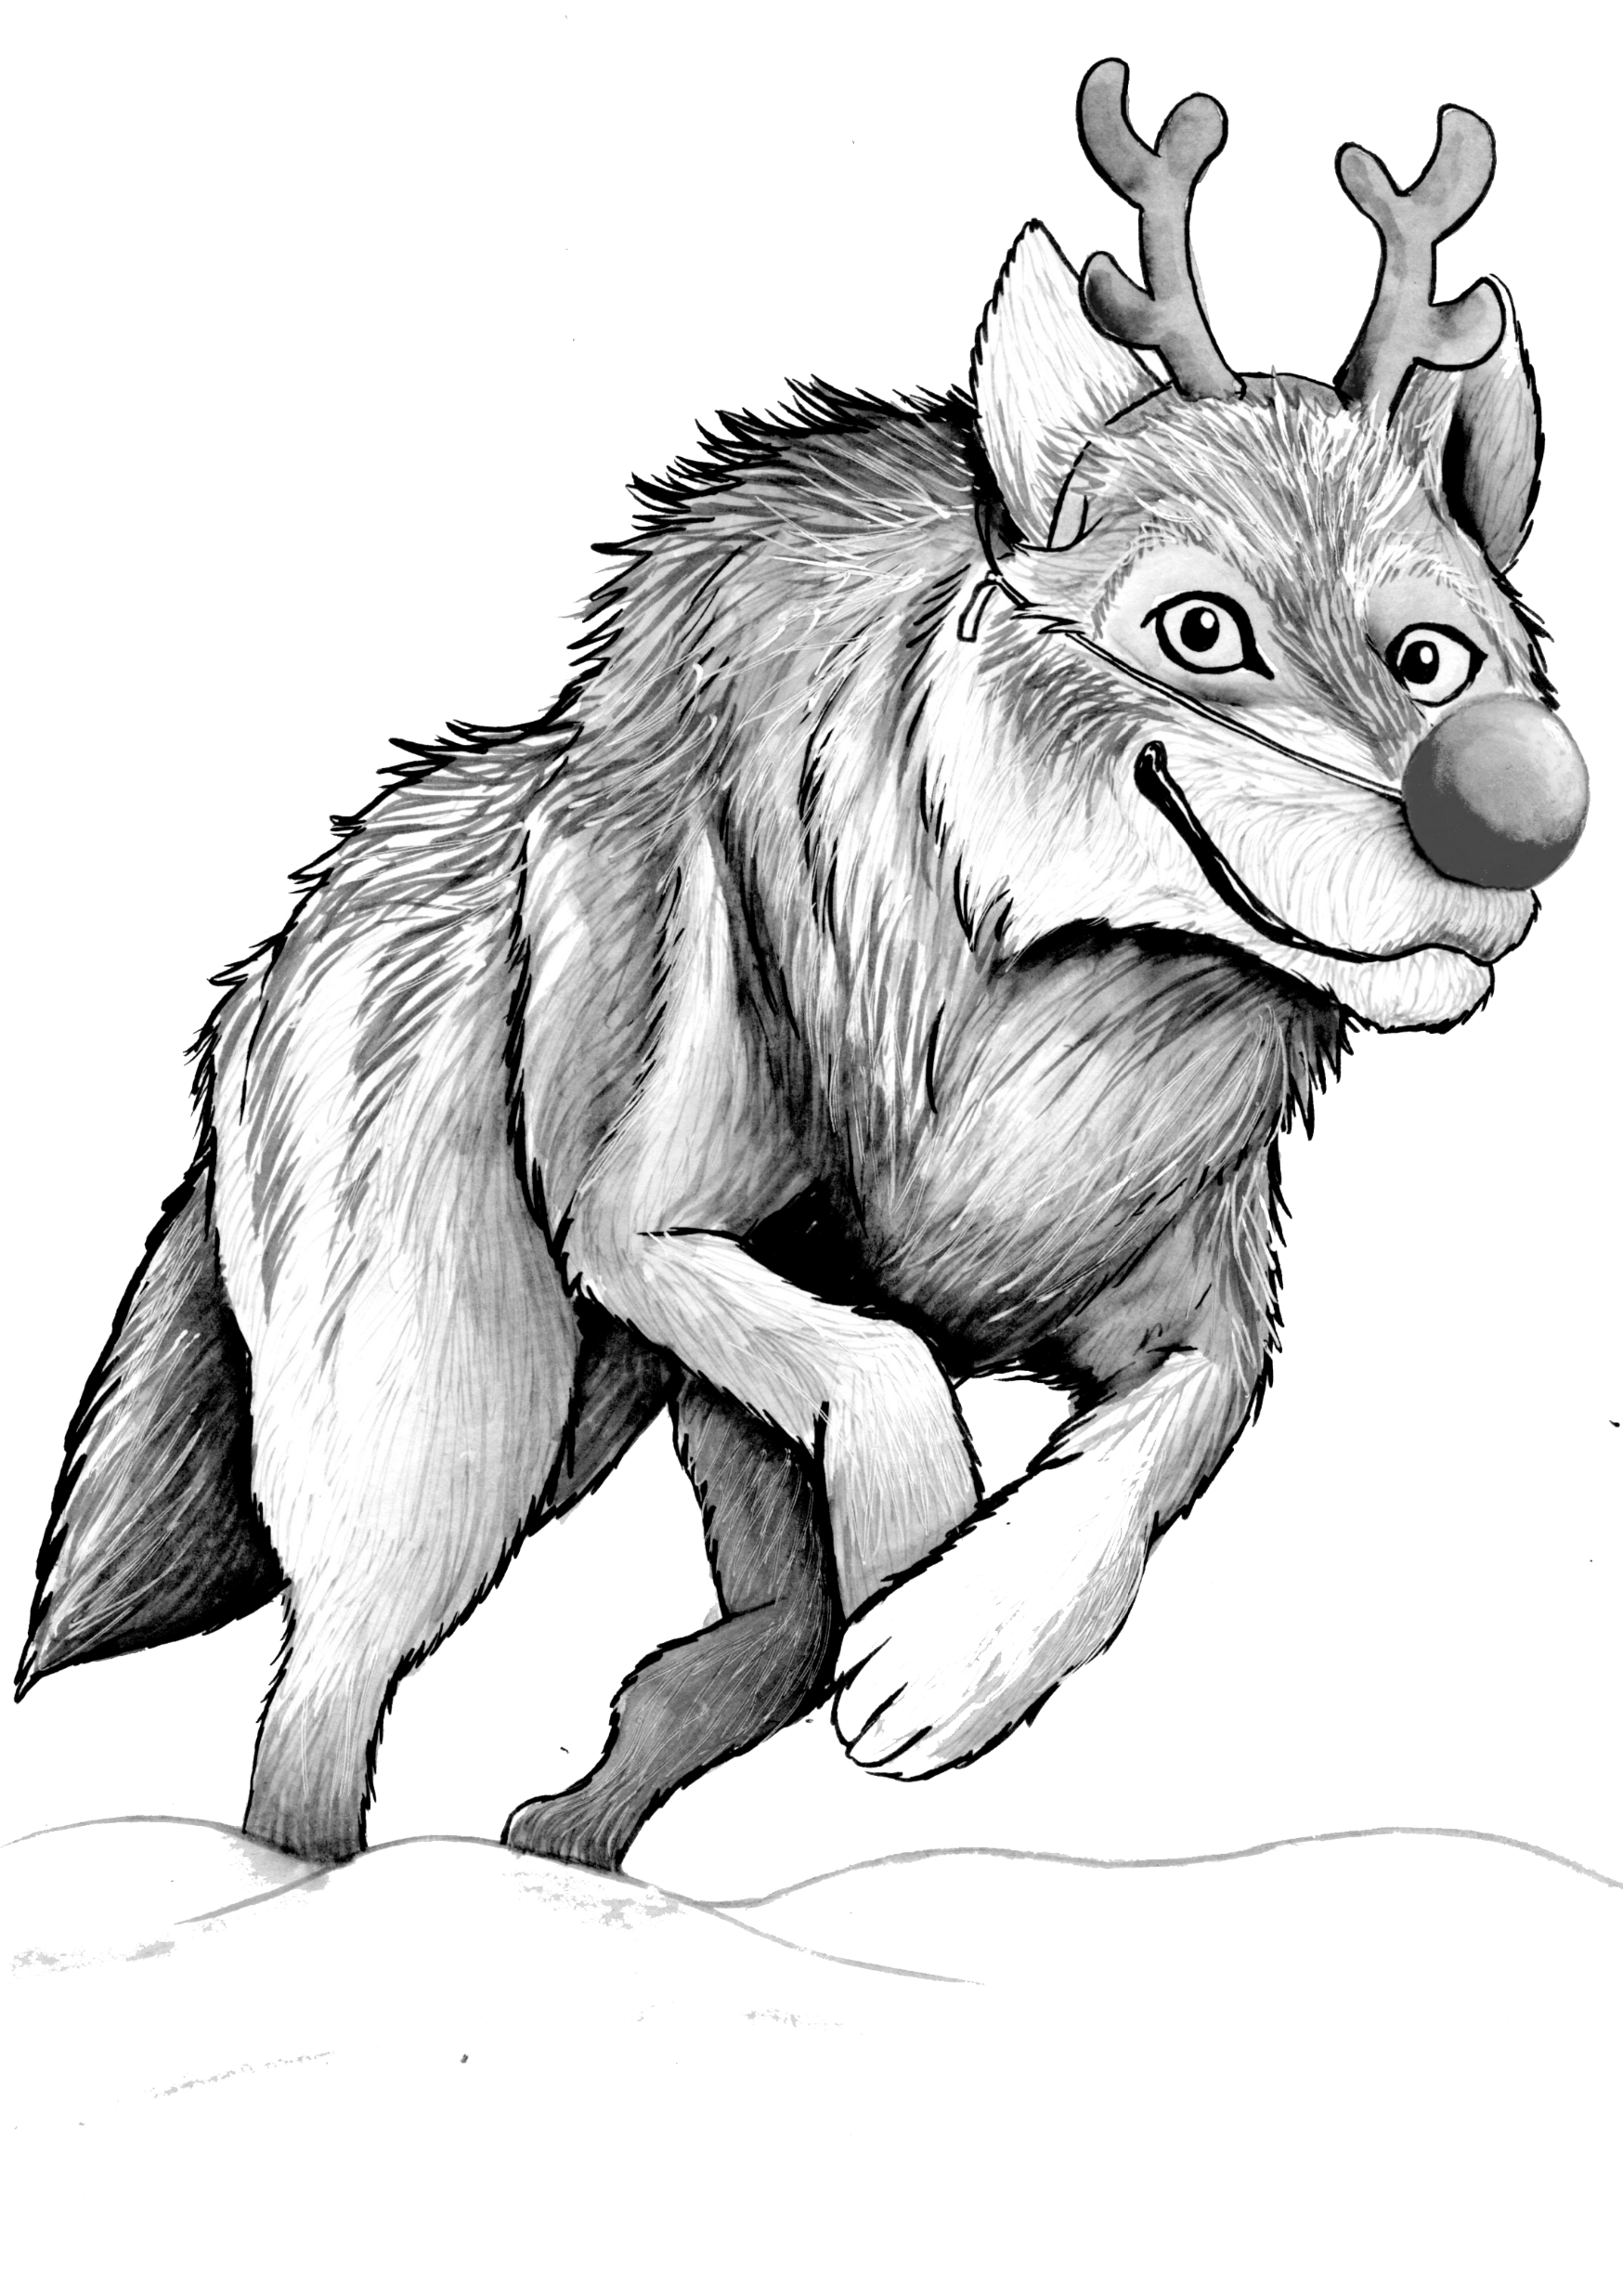
It’s Christmas!
Read closely and carefully the etymology of the word Rudolph.

Slide 5
Lesson 3
It’s Christmas!
Lesson 3
/f/
fun
Task 2. Check your understanding of these festive words by matching the words to the definitions.
/f/
fun
f
ff
ph
gh
f
ff
ph
gh
profession
sacrifice
Task 3. The word festive means ‘linked to a festival especially Christmas.’ Explain how you do you think the word festive might smell, sound taste and feel.
profession
sacrifice
Scrooge is someone who spends as little money as possible and is not generous.
Scrooge is the main character in the novel A Christmas Carol by Charles Dickens, Scrooge hates Christmas.
/sh/ coded ssi
/igh/ coded i_e
/sh/ coded ssi
/igh/ coded i_e
Tidings means ‘news.’
The angel brought tidings of great joy.
tinsel
carols
decorations
Scrooge
tidings
greetings
feast
celebration
lights
turkey
rejoice

Slide 6
It’s Christmas!
Pair up.
With a partner how many festive words can you list or name?

